Slide 1


Project Title - Glaucoma Detection using Ensemble and Transfer Learning
BHARATI VIDYAPEETH DEEMED TO BE UNIVERSITY
DEPARTMENT OF ENGINEERING AND TECHNOLOGY, NAVI MUMBAI
DEPARTMENT OF COMPUTER SCIENCE AND ENGINEERING
Project Members- Abhishek Joshi, Baasim Riyaz Kondkari, Krishna Patel, Om Patil
Guide- Prof. Vivek Solavande

Slide 2
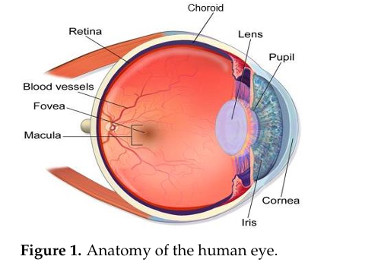
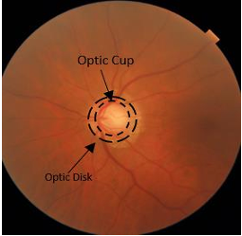
Introduction
Objective
Early detection of glaucoma to prevent irreversible vision loss.
Utilize deep learning techniques for accurate diagnosis.
Key Focus Areas
Segmentation: Precise identification of optical disc and cup.
CDR Calculation: Measure Cup-to-Disc Ratio for glaucoma detection.
Transfer Learning: Leverage pre-trained models (e.g., VGG16) for better feature extraction and classification.
Relevance
Enhance diagnostic accuracy and reduce manual intervention.

Slide 3
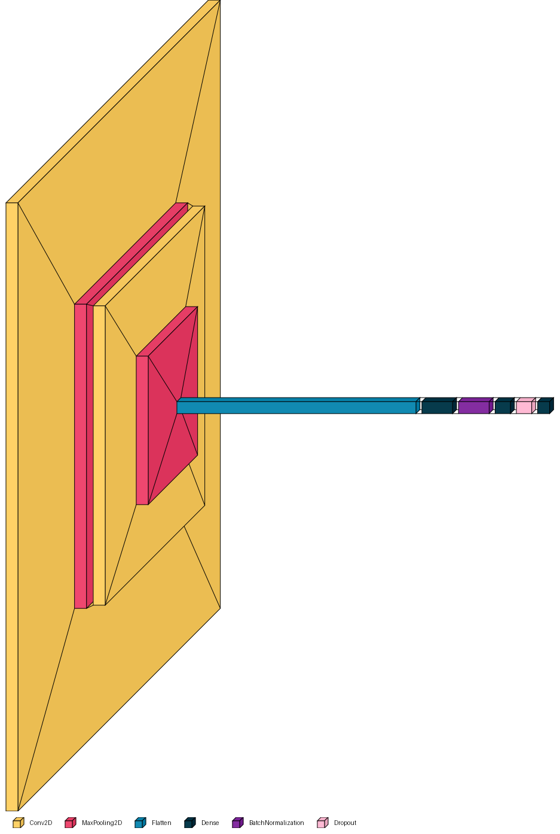
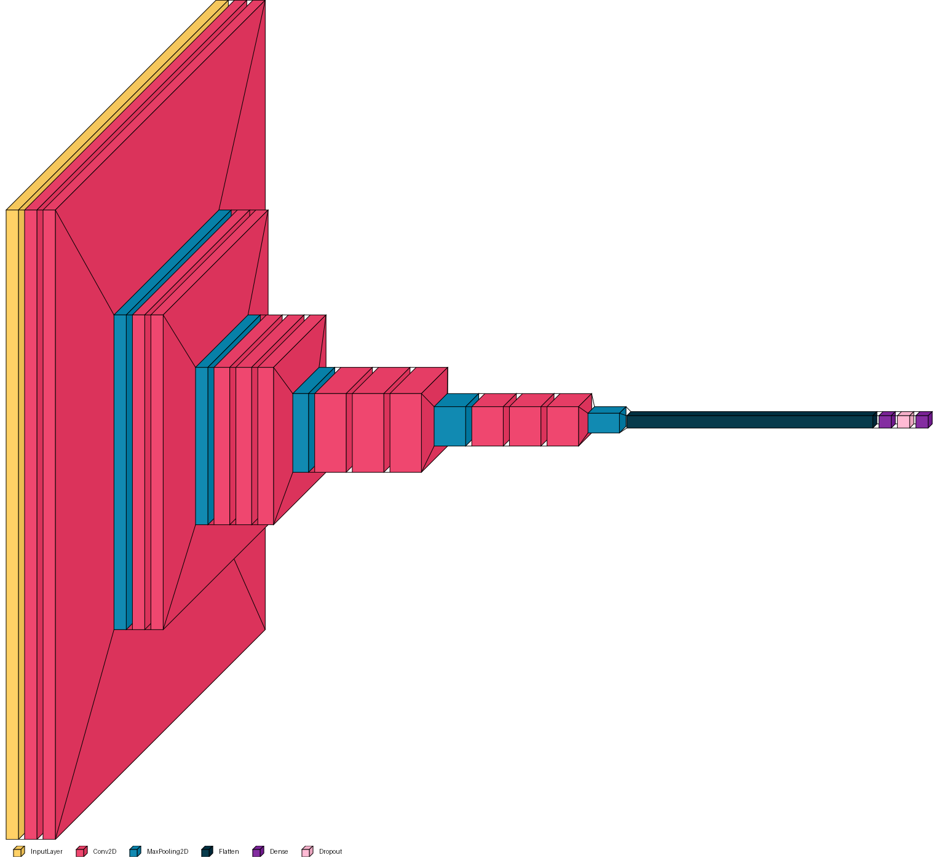
Progress Made
Model Training:
Trained a Vanilla CNN model for glaucoma detection.
Fine-tuned VGG16 model to leverage its advanced feature extraction capabilities.
Segmentation Model:
Developed a model to accurately segment the optical disc and optical cup.
Calculated the Cup-to-Disc Ratio (CDR) to aid in the detection of glaucoma.
Figure 1: Vanilla CNN
Figure 2: VGG16

Slide 4
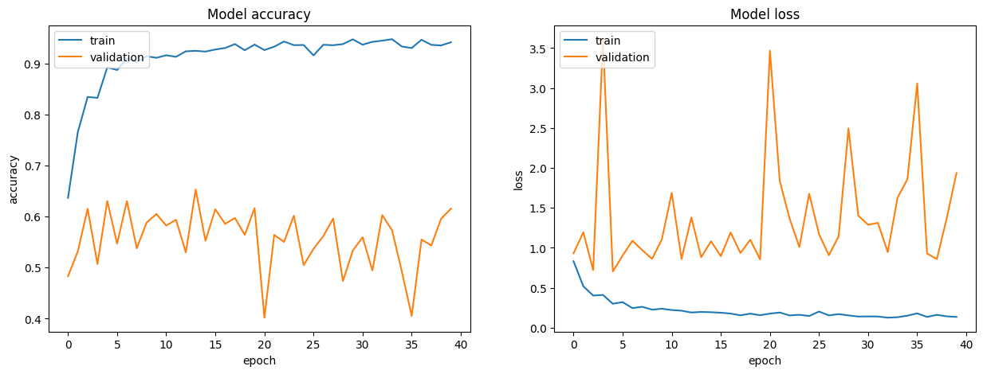
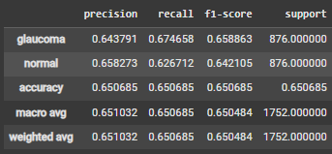
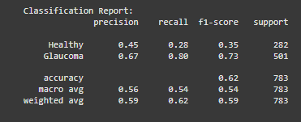
Model Accuracy

Slide 5
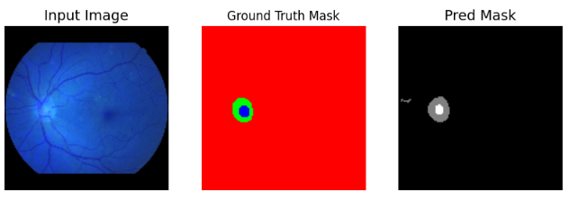
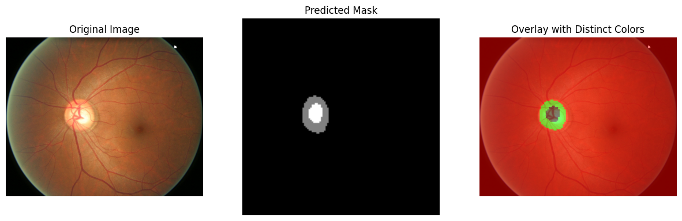

Model Output
This is the output of the segmentation model
Helps to find the optical cup and optical disc ratio
Calculate the vertical height of both he masks
Divide them to get the CDR (Cup to disc ratio)

Slide 6
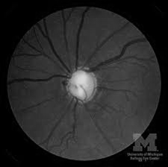
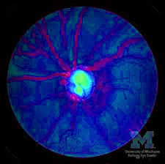
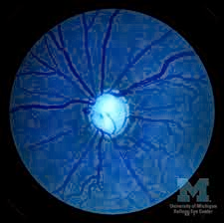
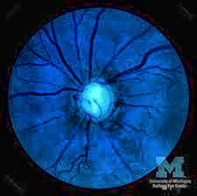
Augmentation with CLAHE
Importance of CLAHE (Contrast Limited Adaptive Histogram Equalization):
Enhanced the contrast of fundus images.
Improved visibility of optical disc and cup for segmentation.
Boosted model performance by preprocessing images with better clarity.
We noticed that augmenting fundus images with CLAHE on the saturation layer enhances accuracy
Figure 1: Just B/W
Figure 2: CLAHE on H channel
Figure 3: CLAHE on S channel
Figure 4: CLAHE on V channel

Slide 7
Further work
Model Training
Train models using ResNet and other state-of-the-art architectures.
Improve accuracy for base model using other augmentation techniques.
Ensemble Techniques
Combine predictions from multiple models for enhanced accuracy and reliability.
Additional Improvements
Optimize segmentation model for precise CDR calculation.
Explore other preprocessing techniques for further contrast enhancement.
Obtaining propritery dataset
Having a labelled dataset will improve model performance.
Tying up with Bharati Vidyapeeth Medicover Hospital to obtain dataset

Slide 8
Thank You

